Slide 1
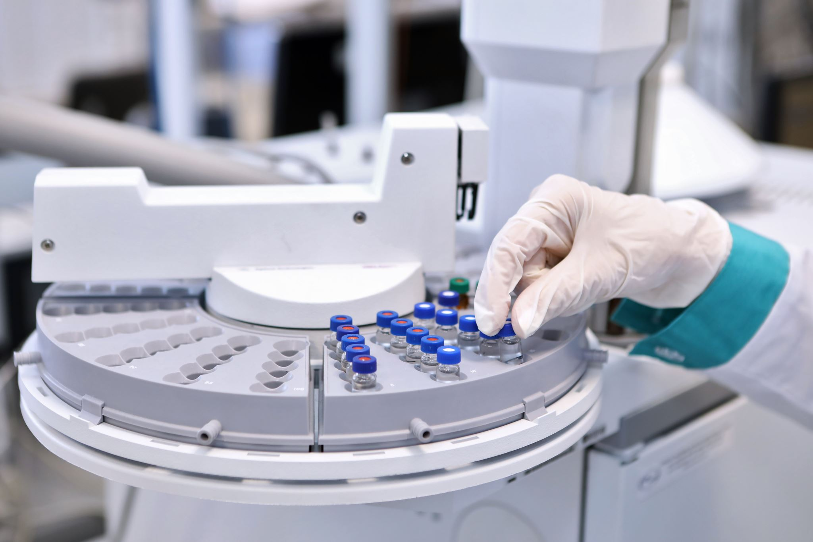
The Future of Drug Discovery: Quantum-Based Machine Learning Simulation (QMLS)
Yifan Zhou
BASIS International School Guangzhou

Slide 2
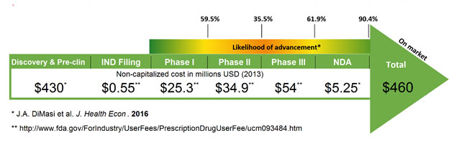
Drug R&D and Its Challenges
Long development time: 5-12 years [1]
Costly: $2.6 billion [2]
Low success rate: 10% [3]

Slide 3
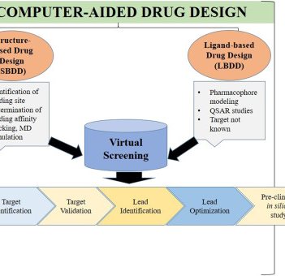
Current Solutions and Drawbacks
Computer-Aided Drug Design (CADD): Relies on existing data
Molecular dynamics simulations (MDS): Requires high computing power & extensive time
[4]

Slide 4
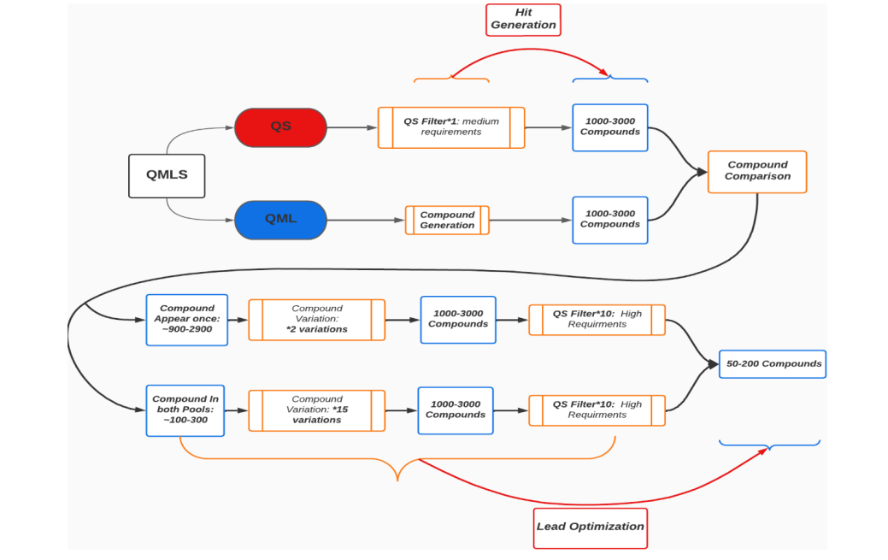
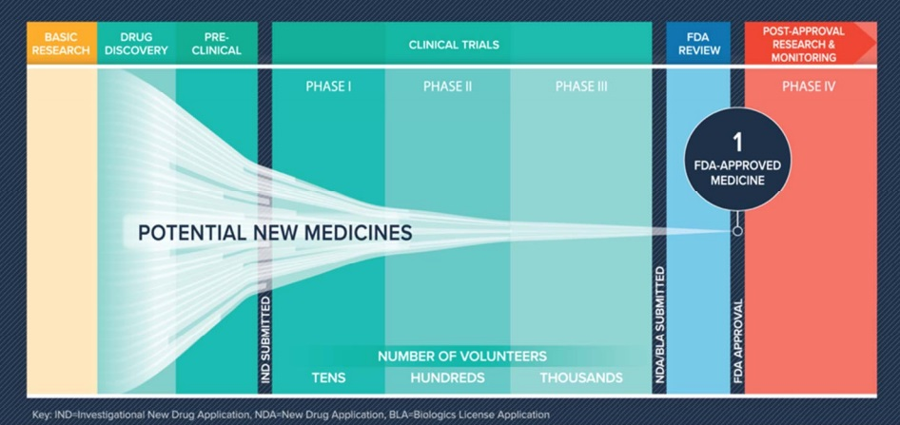
Our Solution: QMLS
Quantum-based machine learning simulation (QMLS)
Machine Learning Molecule Generation (MLG) & machine learning variation (MLV)
Quantum-based simulation (QS)
Hit Generation: MLG + QS
Lead Optimization: MLV + QS
[5]

Slide 5
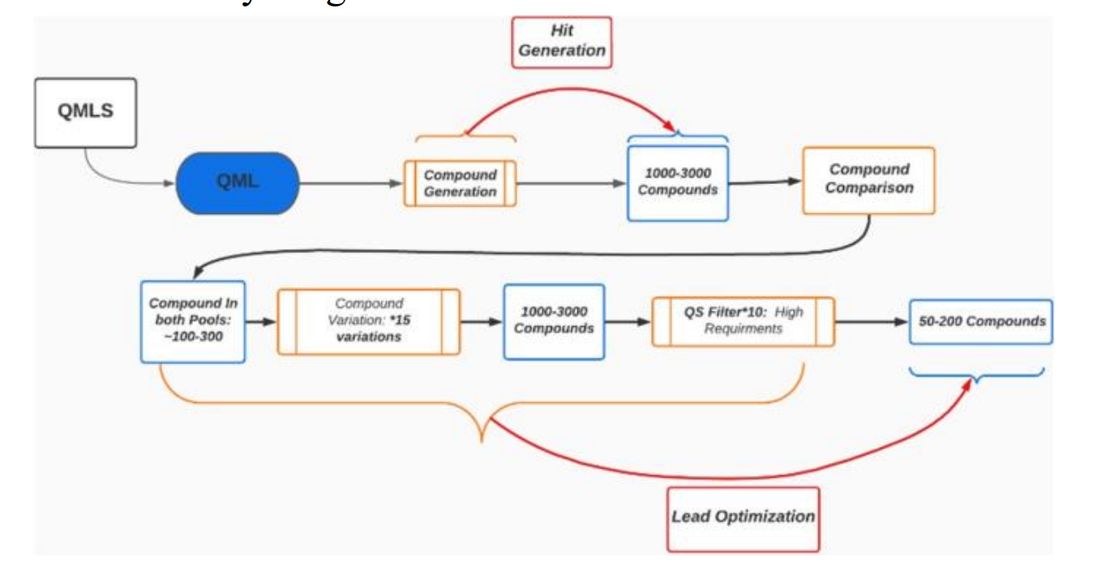
Machine Learning Molecule Generation (MLMG)
Responsible for generating possible drug candidates based on the molecular structure of the target protein or gene
Transfer Learning: 4 Tasks
Uses quantum generative models: QGANs

Slide 6
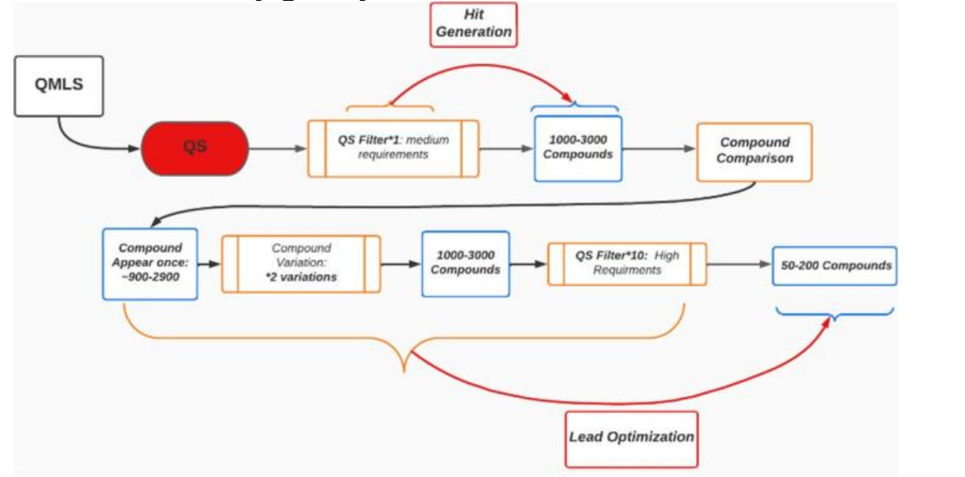
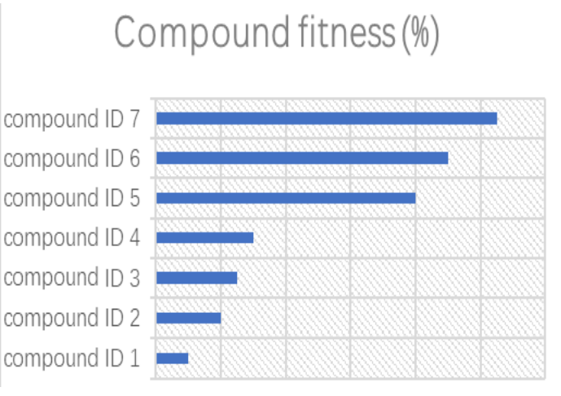
Quantum-based Simulation (QS)
Responsible for filtering out existing known molecules based on their reaction and binding effectiveness with the target protein or gene
Uses quantum simulation tools: OpenMM & qiskit.org’s

Slide 7
Machine Learning Molecule Variation (MLMV)
Responsible for creating variations and modifications of the filtered molecules based on their fitness scores
Similar to QGAs

Slide 8
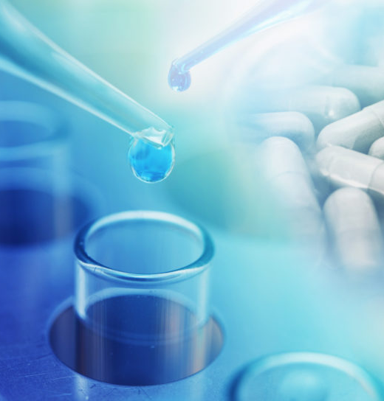
Conclusion
QMLS is purely theoretical
Needs future testing on feasibility, reliability...
Holds great potential
[6]

Slide 9
References
[1] SEQENS, “Want to know why early drug development costs so much?,” CDMO, Mar. 22, 2019. Available: https://cdmo.seqens.com/api-manufacturing/want-to-know-why-early-drug-development-costs-so-much/. [Accessed: Aug. 06, 2023]
[2] D. P. García, J. Cruz-Benito, and F. J. García-Peñalvo, “Systematic Literature Review: Quantum Machine Learning and its applications,” arXiv.org, Jan. 11, 2022. doi: https://doi.org/10.48550/arXiv.2201.04093. Available: https://arxiv.org/abs/2201.04093. [Accessed: Aug. 06, 2023]
[3] R. Divya and J. Dinesh Peter, “Quantum Machine Learning: A comprehensive review on optimization of machine learning algorithms,” IEEE Xplore, Nov. 01, 2021. doi: https://doi.org/10.1109/ICMSS53060.2021.9673630. Available: https://ieeexplore.ieee.org/document/9673630
[4] Science Direct, “Computer-Aided Drug Design - an overview | ScienceDirect Topics,” www.sciencedirect.com, 2019. Available: https://www.sciencedirect.com/topics/pharmacology-toxicology-and-pharmaceutical-science/computer-aided-drug-design
[5] Sean, “The Process and Costs of Drug Development (2022),” FTLOScience, Jun. 27, 2018. Available: https://ftloscience.com/process-costs-drug-development/
[6] “New Solutions For Revitalizing Big Pharma R&D,” Biotech Connection. Available: https://biotechconnectionbay.org/viewpoint/new-solutions-for-revitalizing-big-pharma-rd/. [Accessed: Aug. 06, 2023]

Slide 10

Thank You! Questions?

